Slide 1
NATURE
Presentation title
Powerpoint is a complete presentation graphic package it gives you everything you need to produce a professional-looking presentation

Slide 2
CONTENTS
01. Contents title
01-1. Contents title
01-2. Contents title
01-3. Contents title
02. Contents title
02-1. Contents title
02-2. Contents title
02-3. Contents title

Slide 3
01
Environmental Festivals

Slide 4



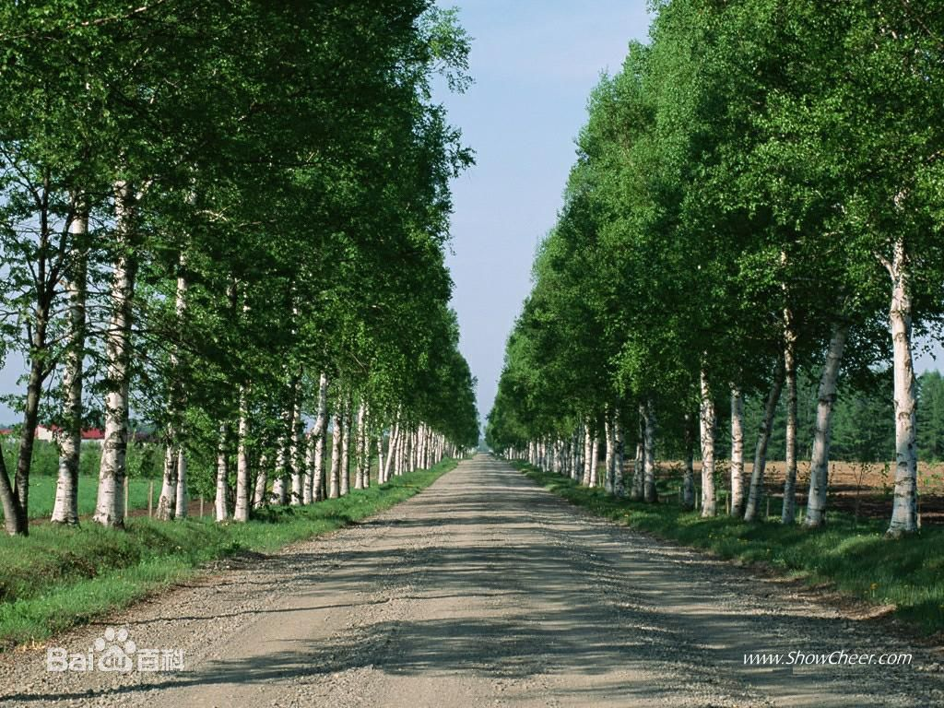



Tree Plangting cultrue
Why we need tree?
Our user-friendly and functional search engine helps you locate the right templates, effectively saving your time.
expand the forests resources
keep water and soil floating away
protect farms and adjust the environment

Slide 5




Tree Planting Day
from all over the world
Our user-friendly and functional search engine helps you locate the right templates, effectively saving your time.
According to the research of the UN, more than 50 countries have established Tree Planting Day.
Asia
Europe
North
America
Middle East
Africa
South
America
Oceania

Slide 6

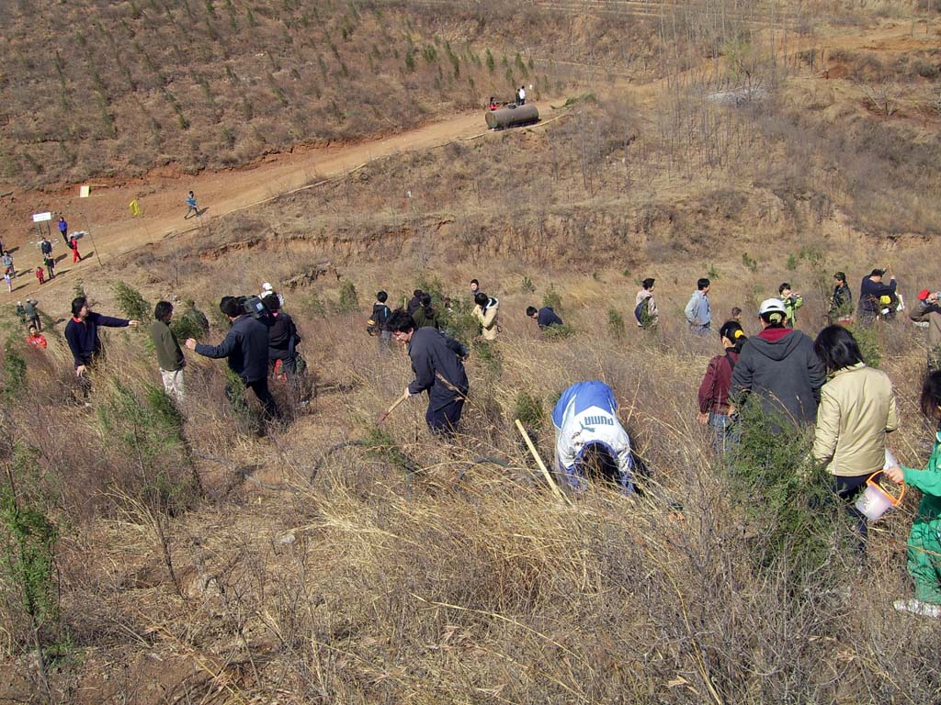




Tree Planting Day
in China
May 12th every year
in honor of Sun Zhongshan
has lasted for 91 years

Slide 7
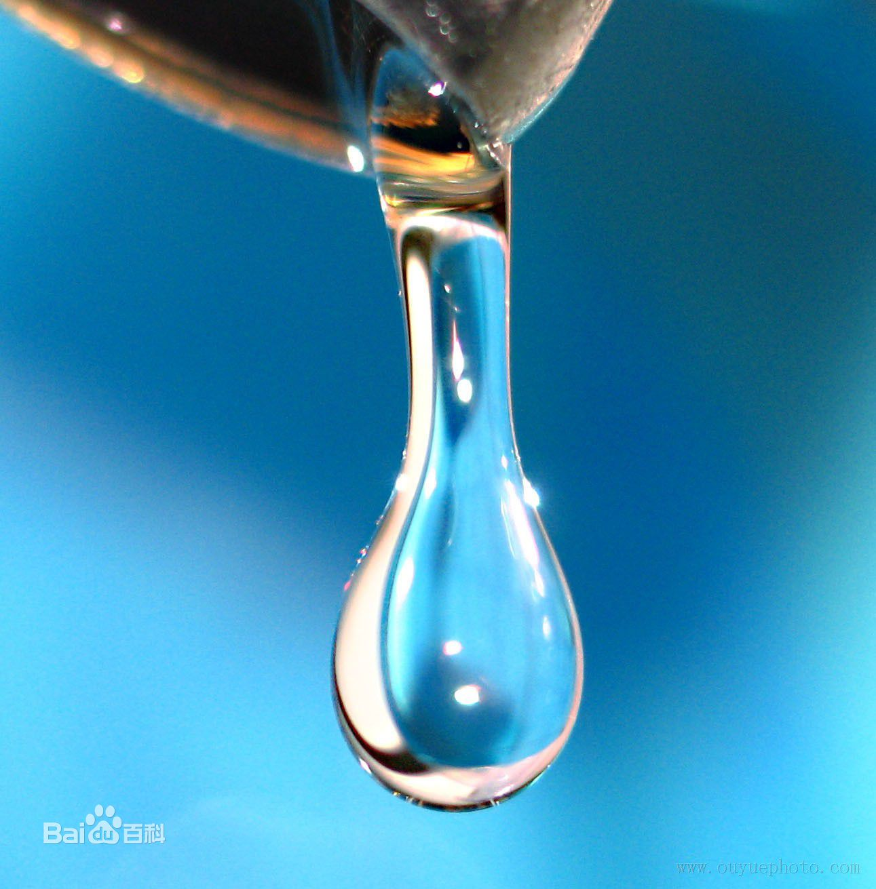


World Water Day
integrated management of water resource
solve the problem of lack
of fresh water
launched in May 22th, 2005

Slide 8
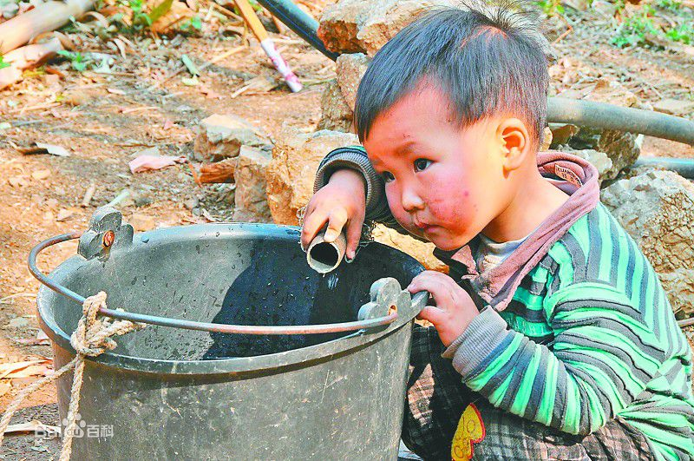
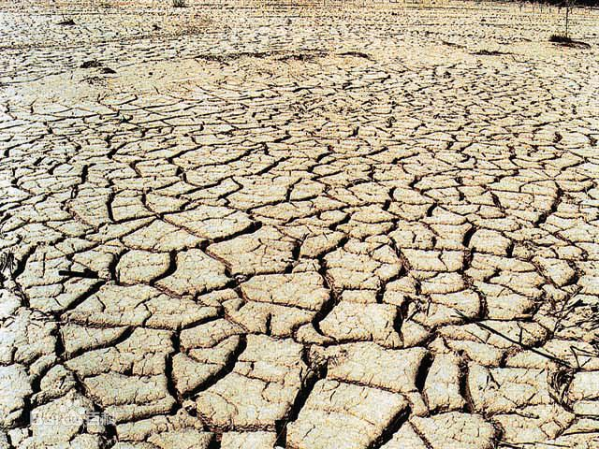
World Water Day
What if we have no water?

Slide 9

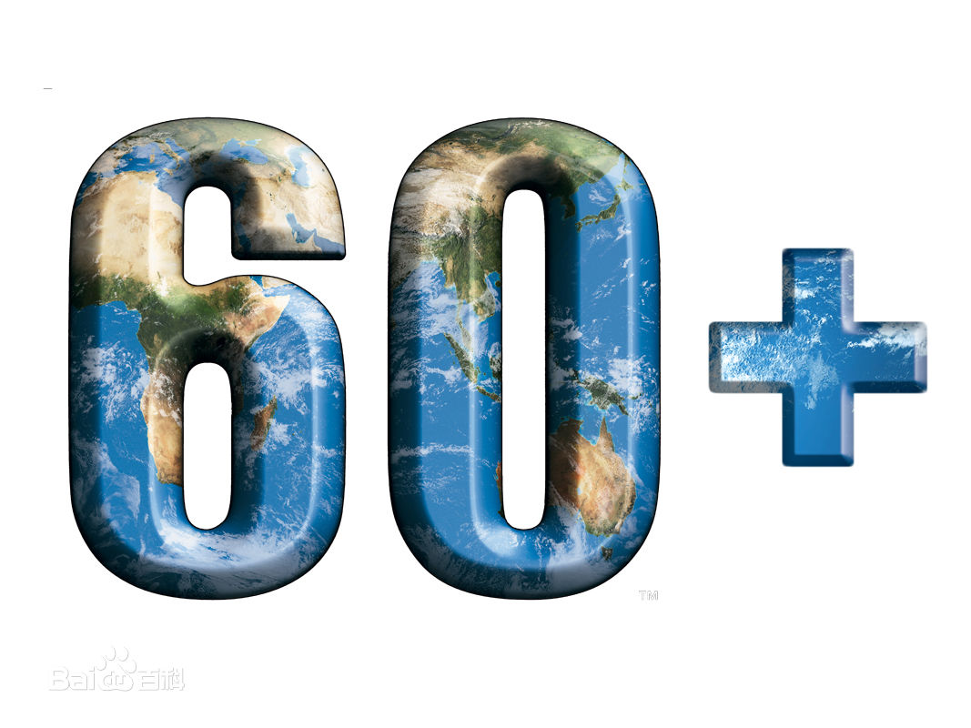
Earth Hour
One hour, one earth
Our user-friendly and functional search engine helps you locate the right templates, effectively saving your time.
launched in 2007 by World Wildlife Fund(WWF)
provoke people’s thought of climate and environment problem through the light-off in one hour

Slide 10
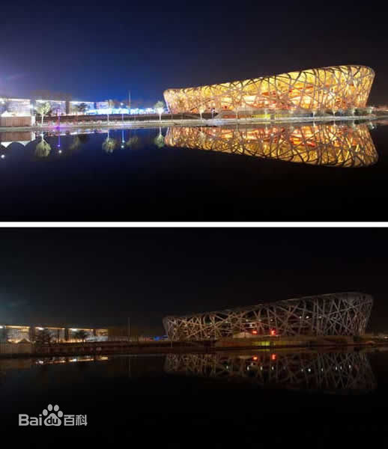
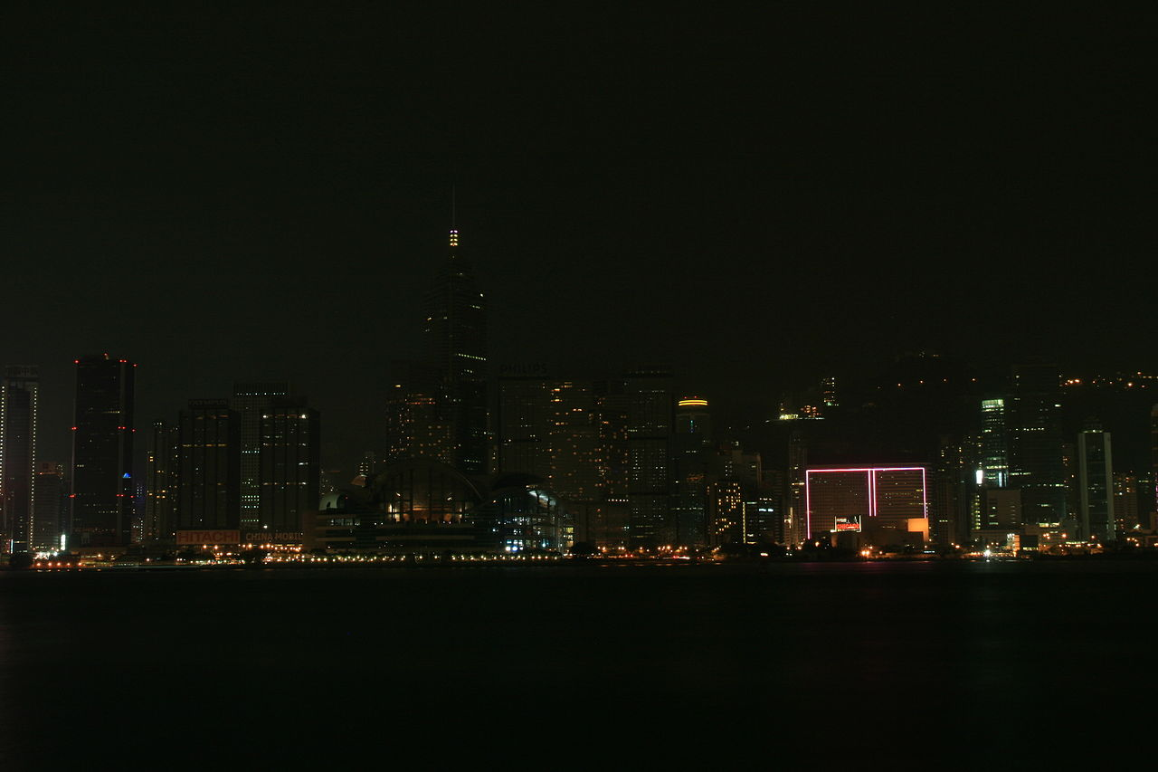
Earth Hour
One hour, one earth

